Slide 1
Final Project
Group Name: DBMS Knights
Group Members
Siddhartha Dimania
Indrajit Swami Kavit Mehta
Kaustubh Rajput

Slide 2
Purpose / Overview
Summary:
This System provides the User a single combined online platform where a person can purchase different banks cards from a single website.
The website will have banks and if a person clicks on a bank, the site will open a list of cards related to that bank and the person can easily purchase that card instead of search different card though the whole internet.

Slide 3
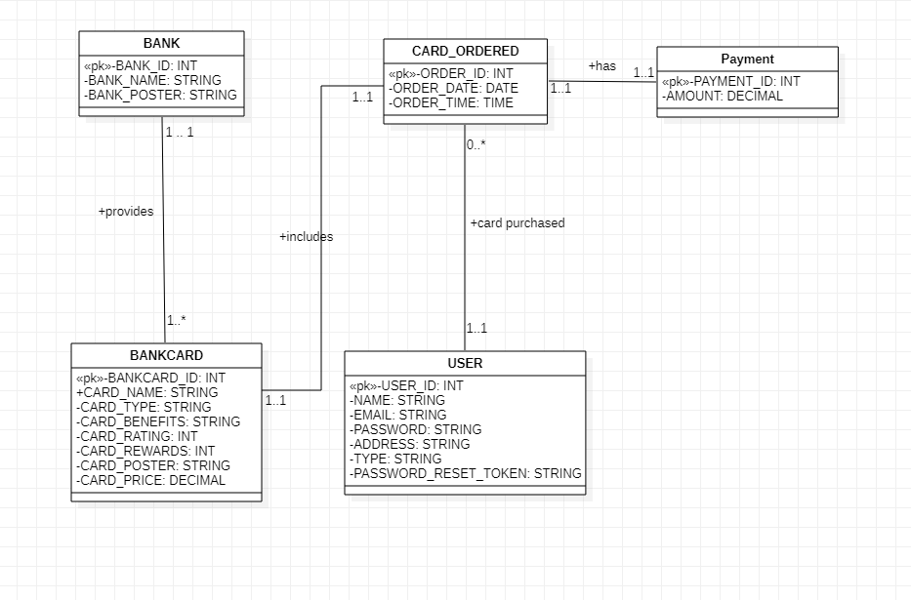
UML Class Diagram

Slide 4
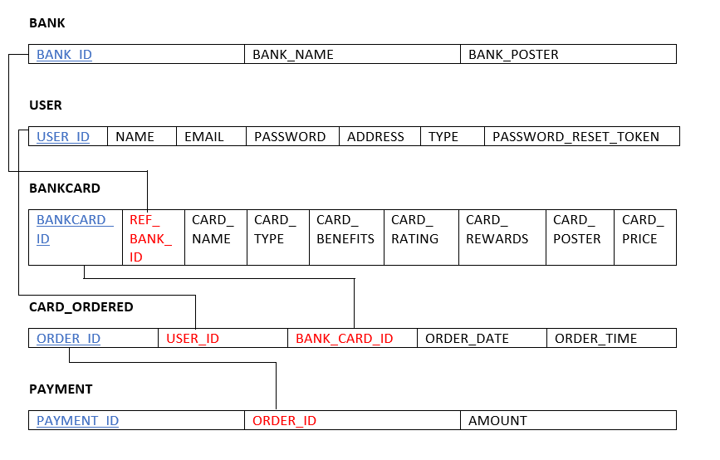
UML Class Diagram to Relational Model
*Primary keys : Blue. *Foreign Keys: Red

Slide 5
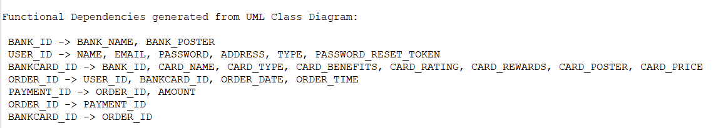
Functional Dependencies:

Slide 6
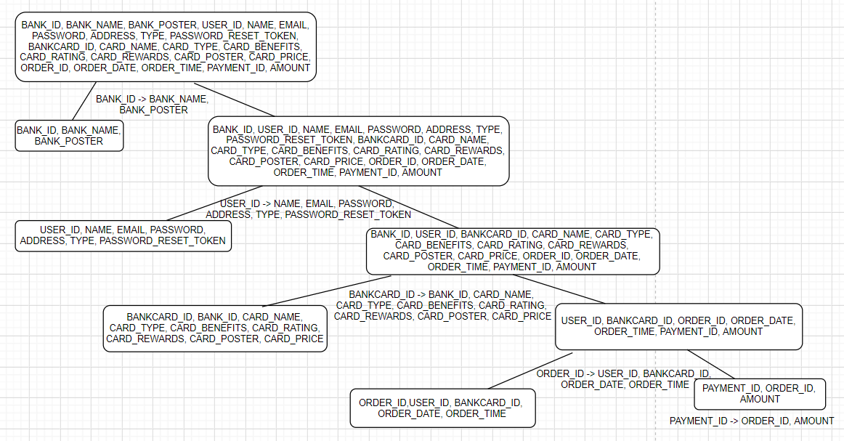
BCNF Decomposition

Slide 7
BCNF Decomposition
ORDER_ID -> PAYMENT_ID,
BANKCARD_ID -> ORDER_ID.
BCNF doesn’t have these fds since our project design and requirements do not require these FDs to be preserved.
So, our final schema does not contain above two fds.

Slide 8
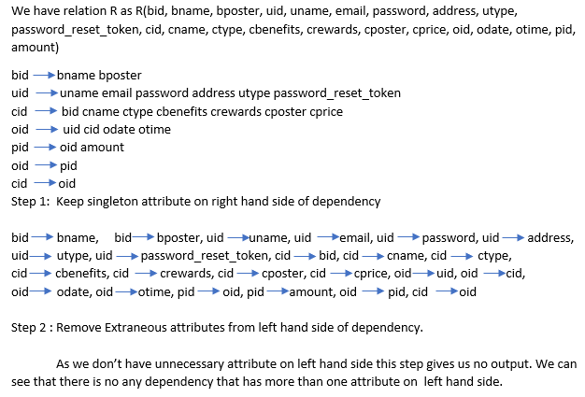
Third Normal Form (3NF) Synthesis Algorithm

Slide 9
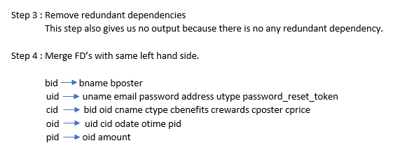

Slide 10
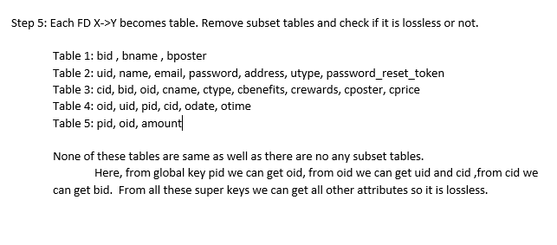

Slide 11
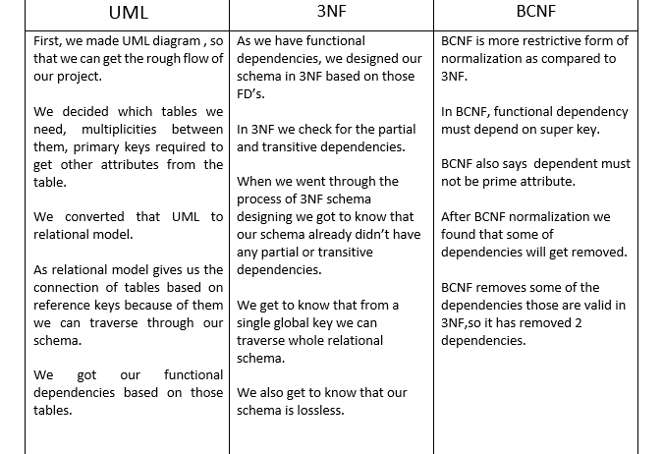
Schema Comparison

Slide 12




Software Architecture
User Interface
Backend
Hibernate
Database
Services

Slide 13
Functionality
Sign-Up
Sign-In
Secure Login
User Profile
Order Purchase
Order History

Slide 14
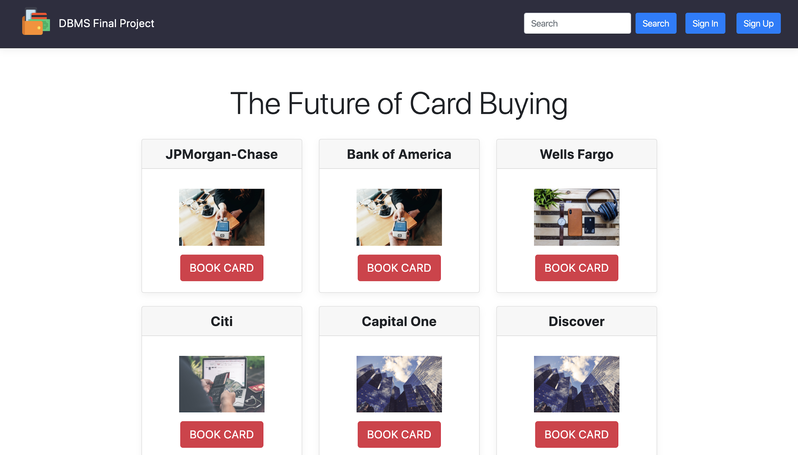
Home View
User login is not required to be able to view all the bank options.
Sign In and Sign Up Functionality is given by providing buttons at top right corner of the page.
Search Functionality is also provided at the top right corner.

Slide 15
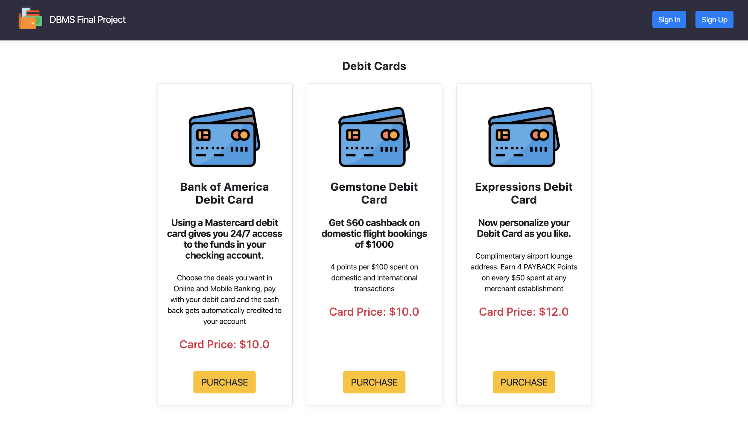
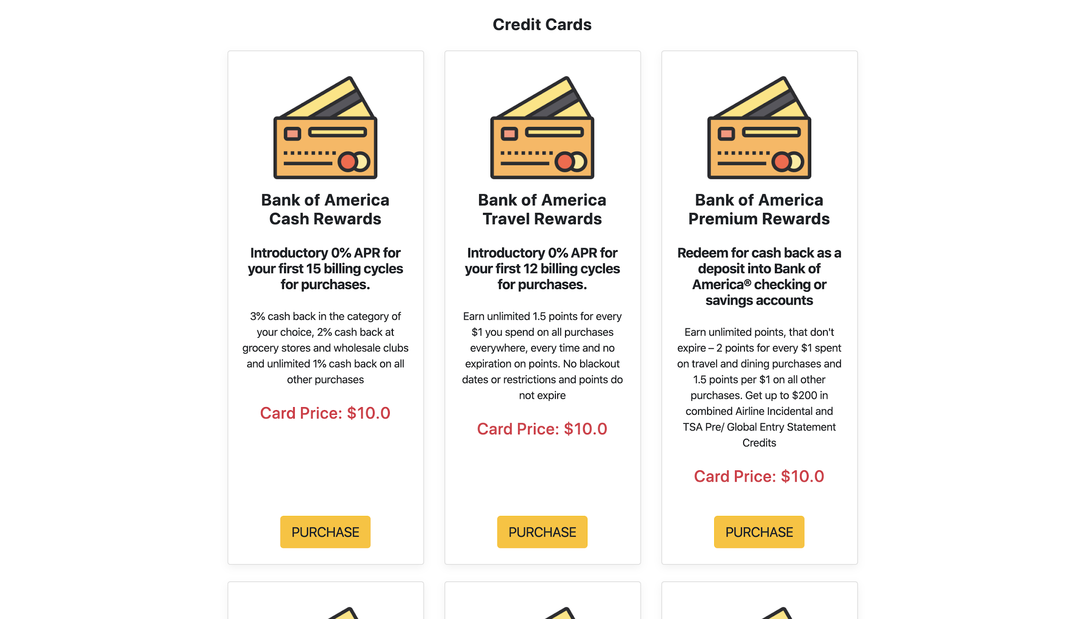
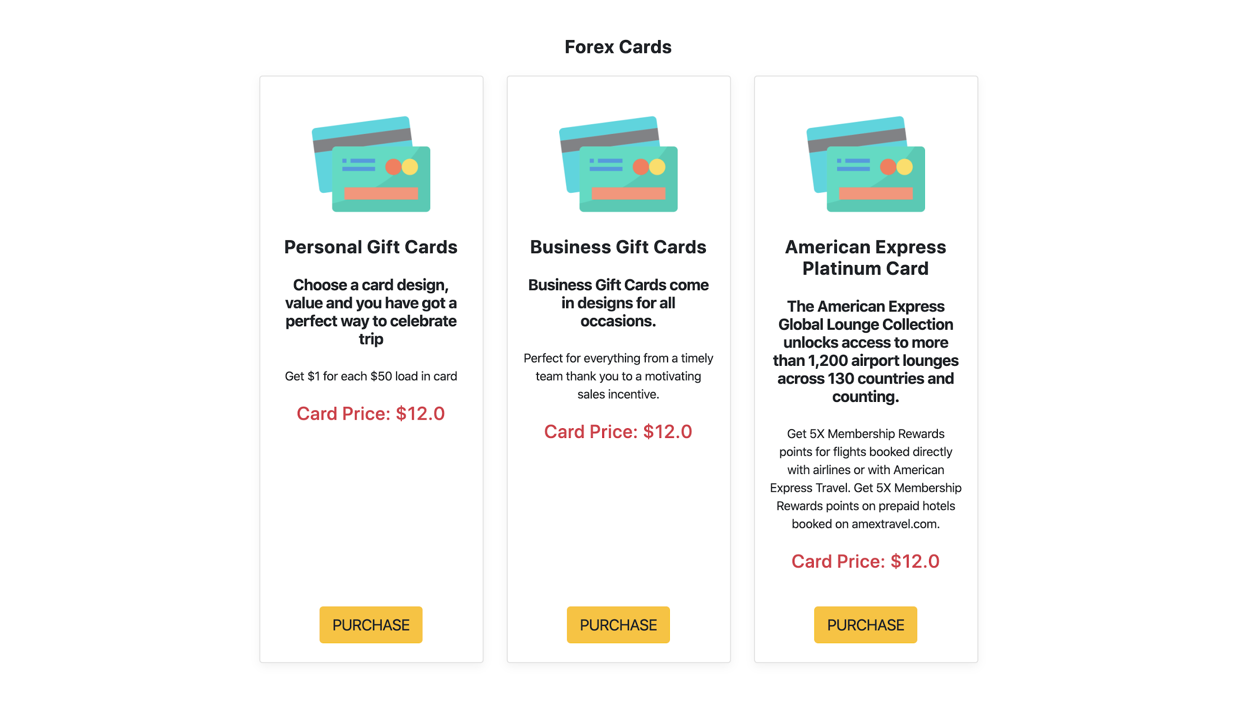
Bank Card View
Debit Cards
Credit Cards

Slide 16
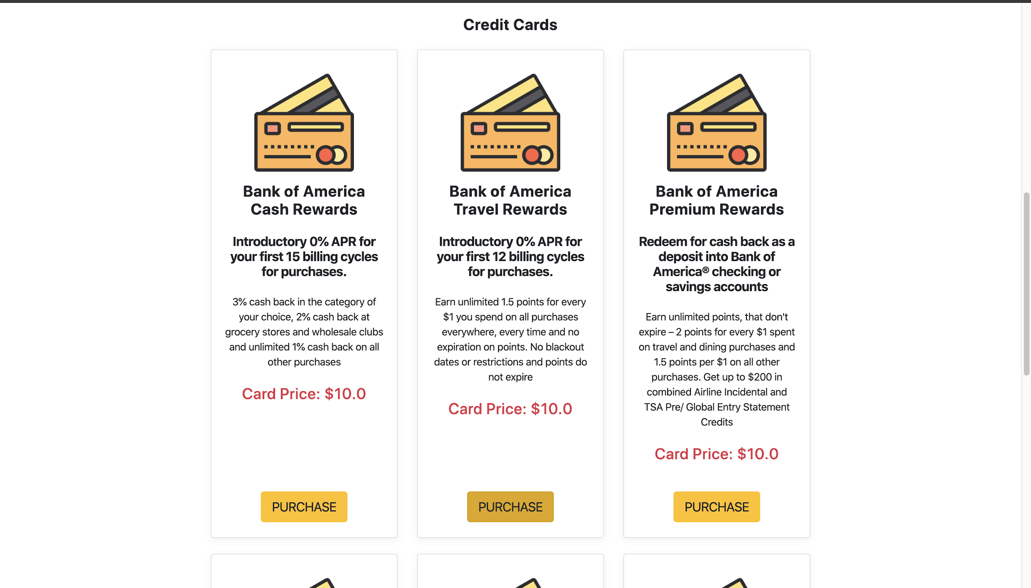
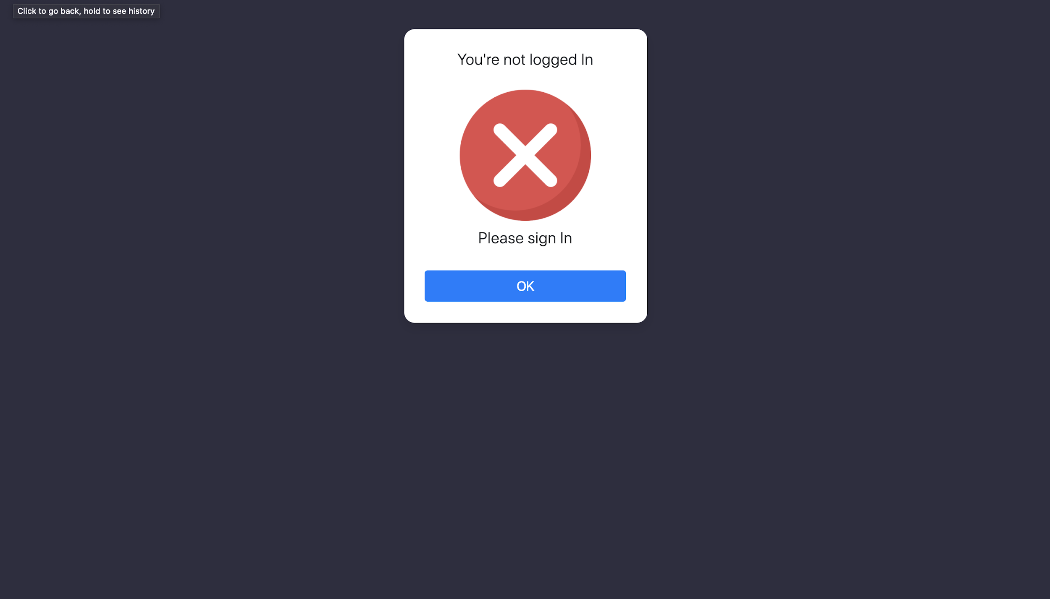
Secure Login
We’re maintaining proper session across the application so that relevant transactions can be only done by logged in user.
On the ‘Bank Card View’, the cards can be purchased only when the ‘User’ is logged in or else it will give an error page.
We concentrated on error generation as well.
We’re using hibernate query functions with proper attributes that’s the reason that sql injection is also not possible through out the application. (next page)

Slide 17
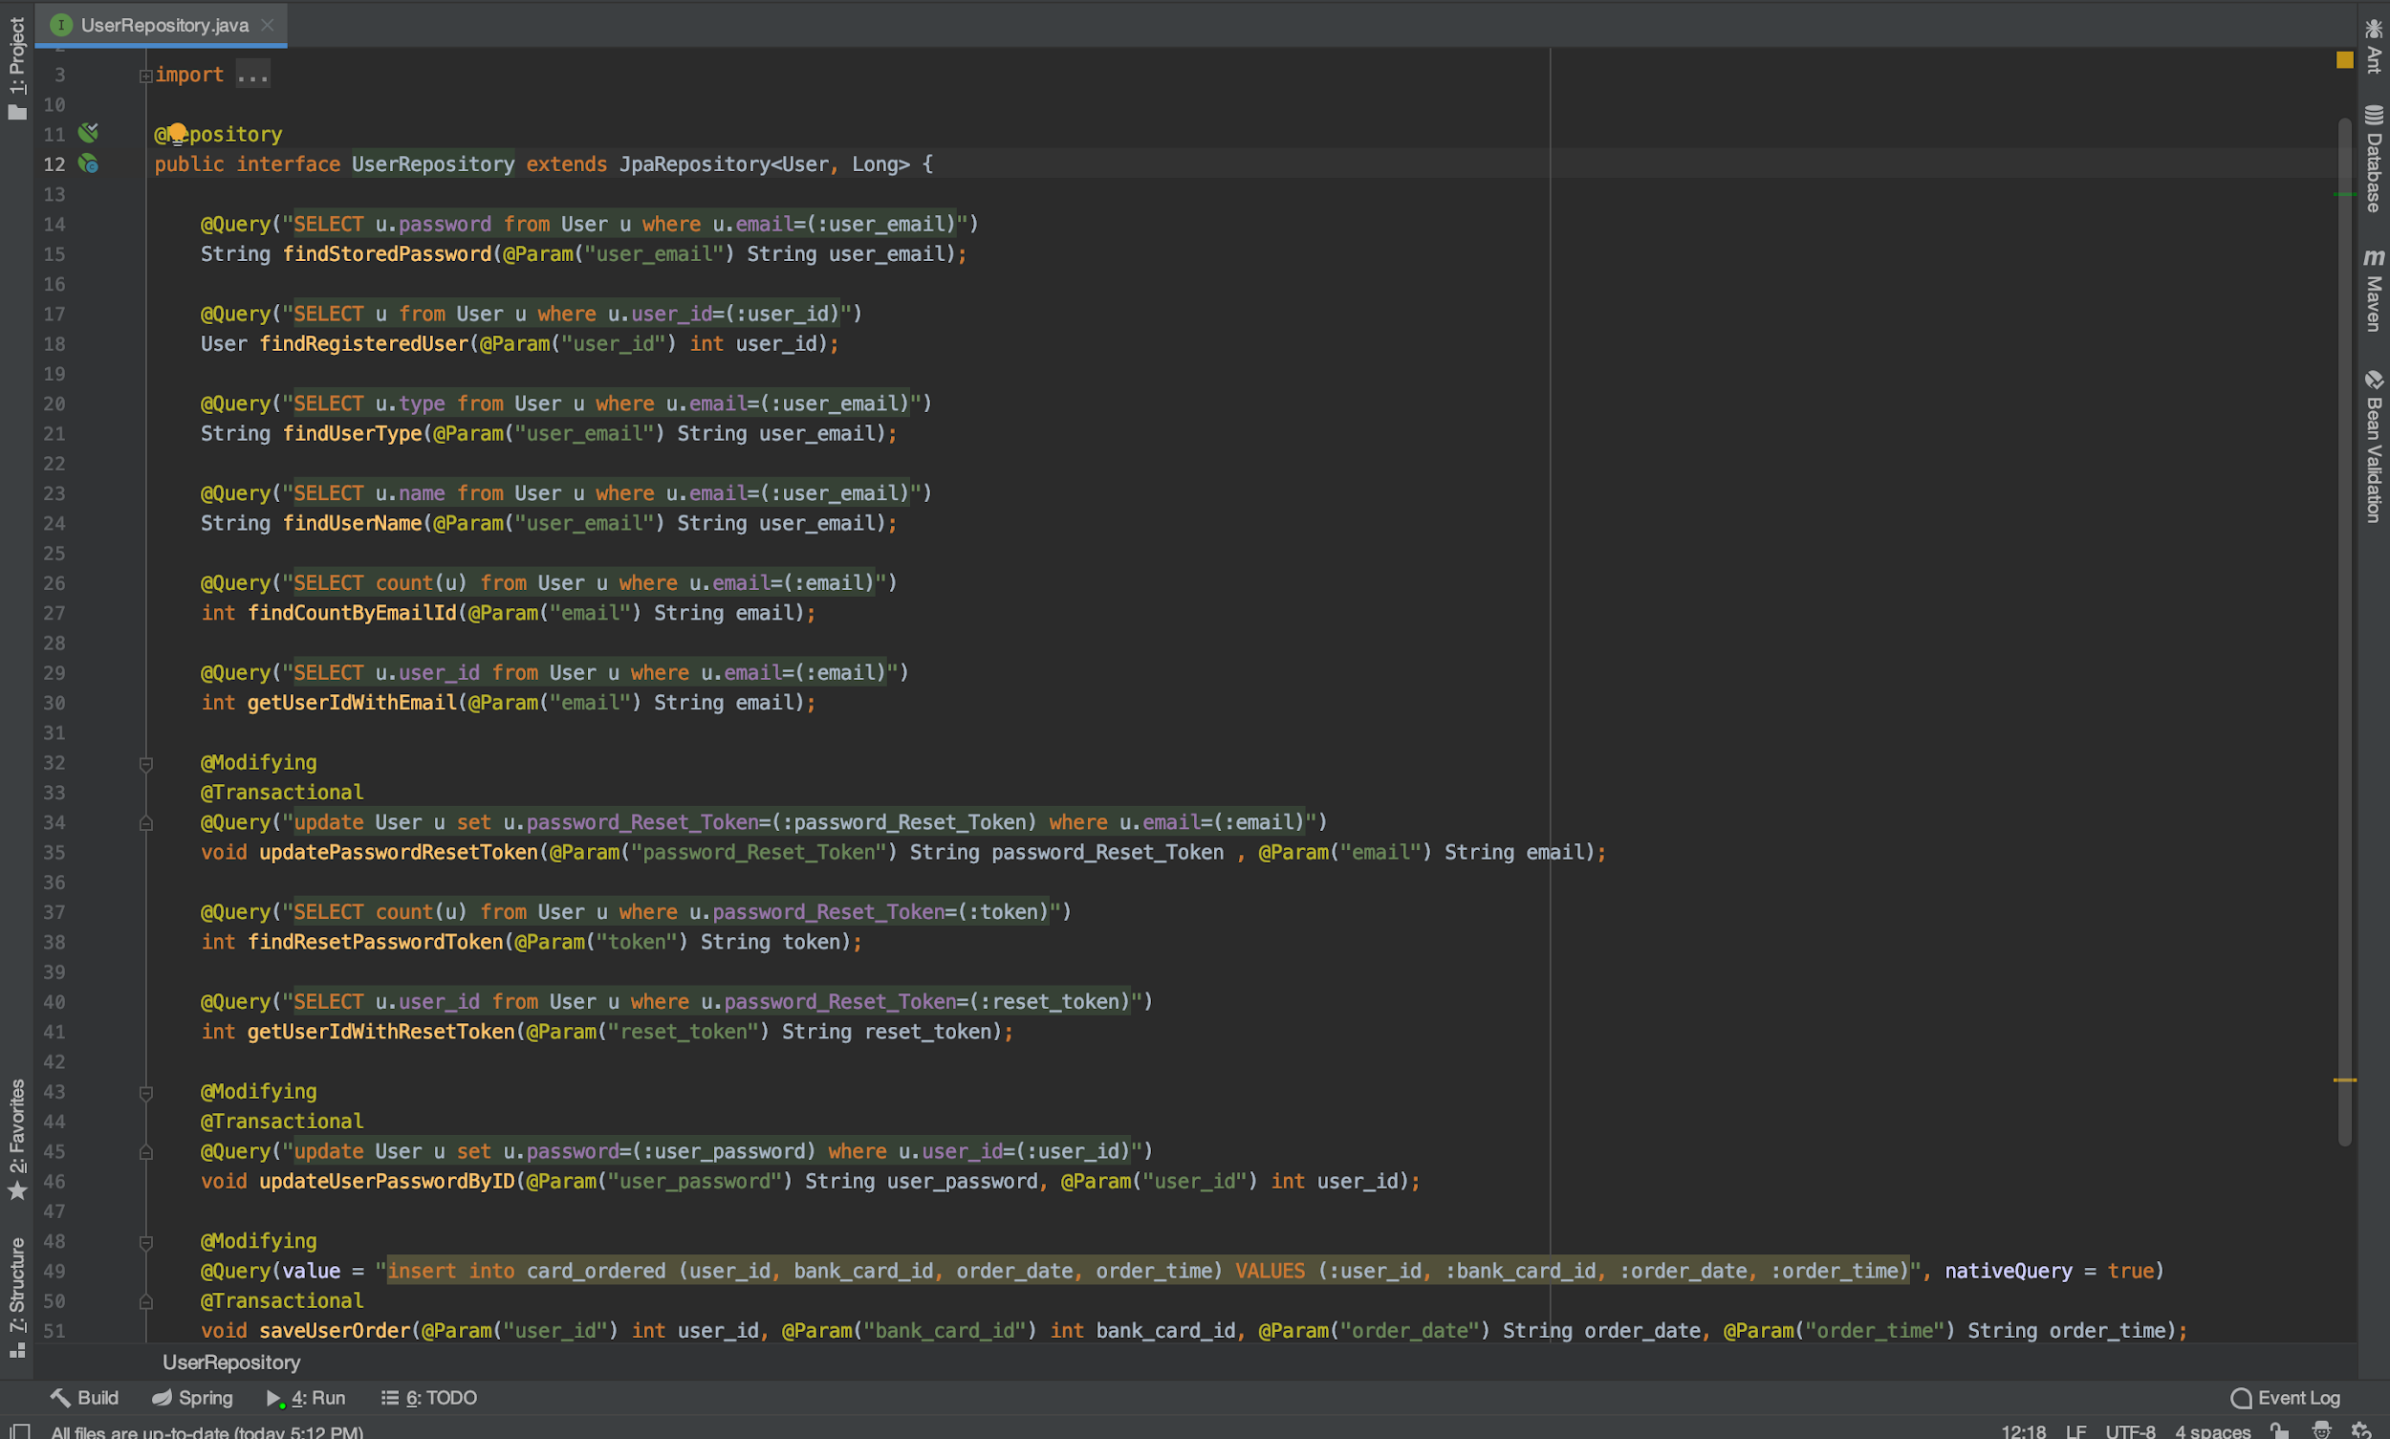
DataBase Query

Slide 18
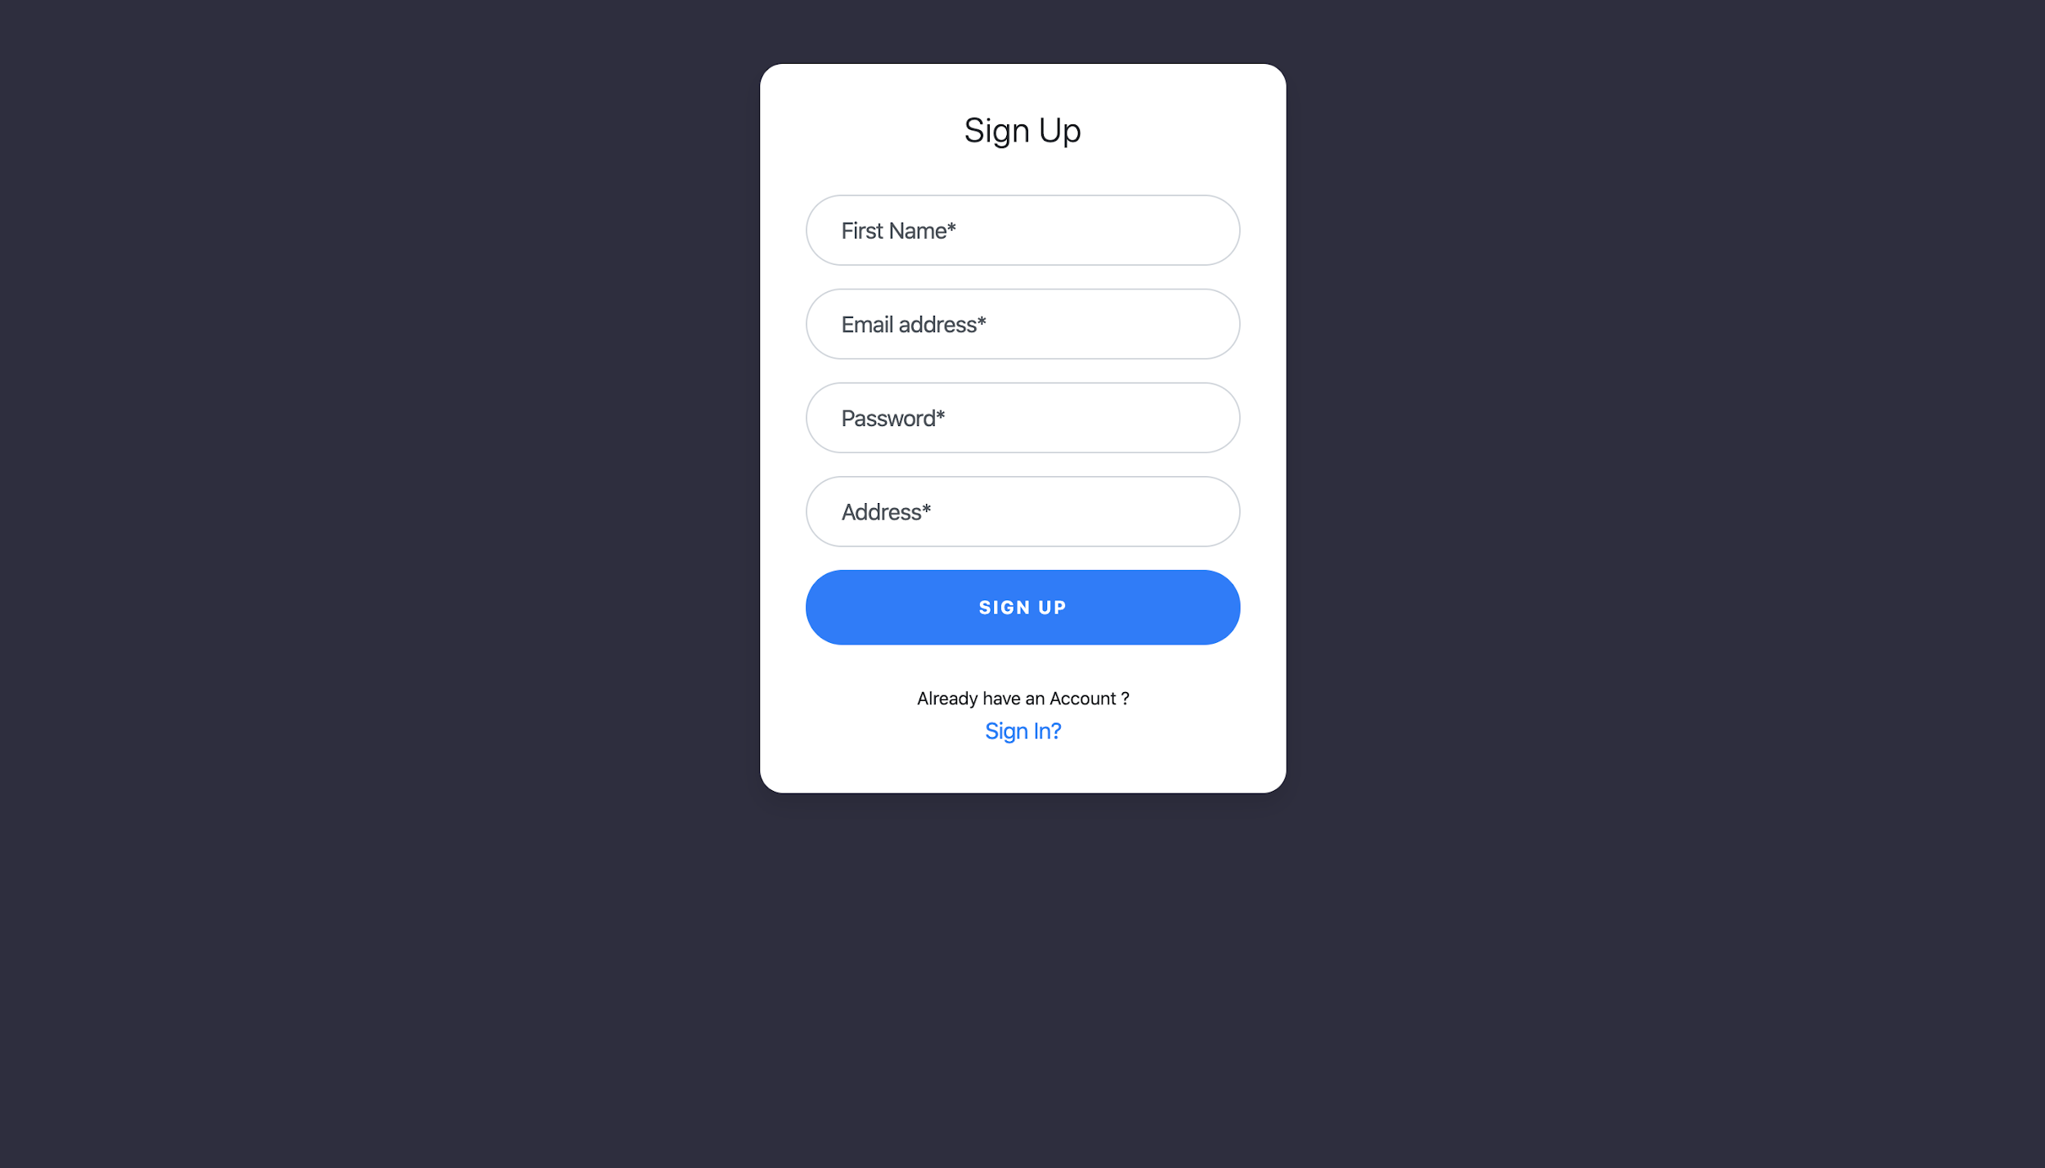
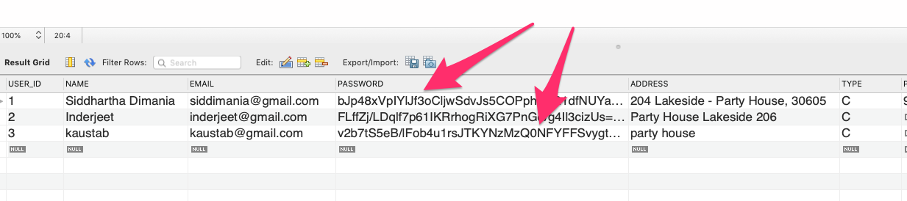
Sign-Up View
Sign-Up view needs following fields to be entered.
First Name
Email address
Password
Address
While saving the password, we’re encrypting it with salted hash. Here we’re computing PBKDF2 hash of the given plaintext password.
With the same password we’re generating different salted hashes. (Given in the Fig.2)
Fig.2

Slide 19
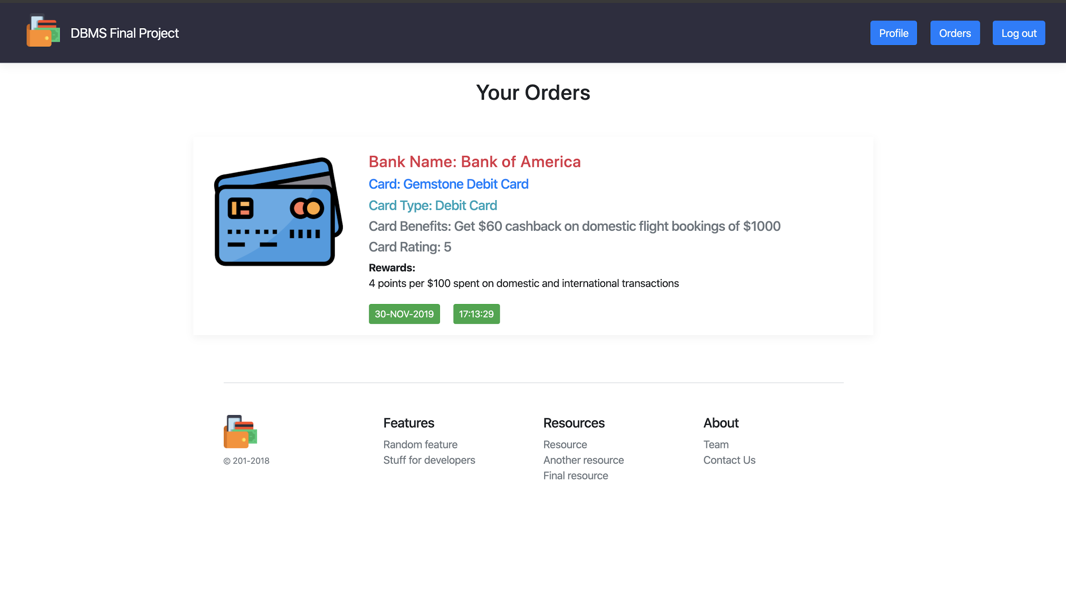
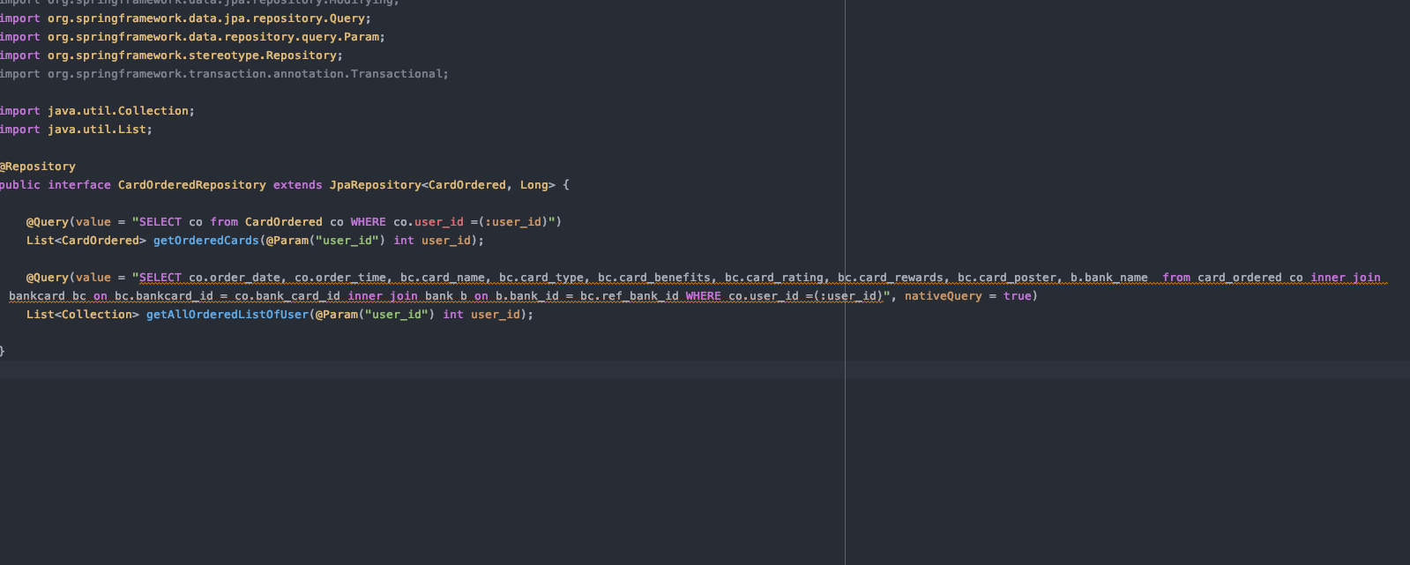
Order Detail View
To show the orders we’re joining three tables: CARD_ORDERED, BANKCARD and BANK.

Slide 20
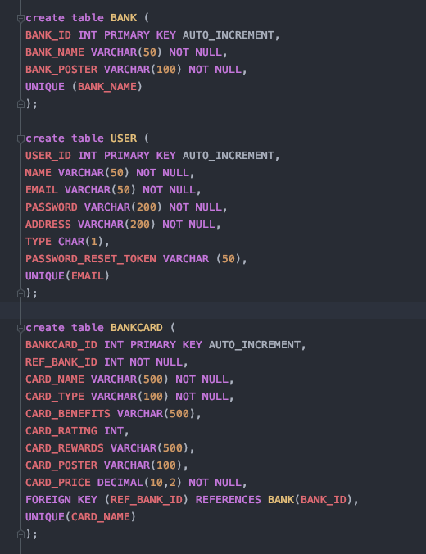
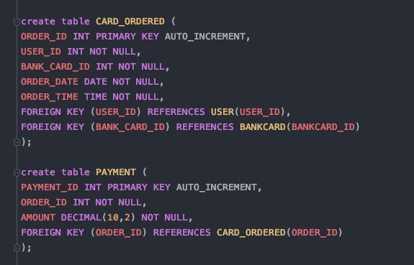
Schema in SQL and Constraints

Slide 21
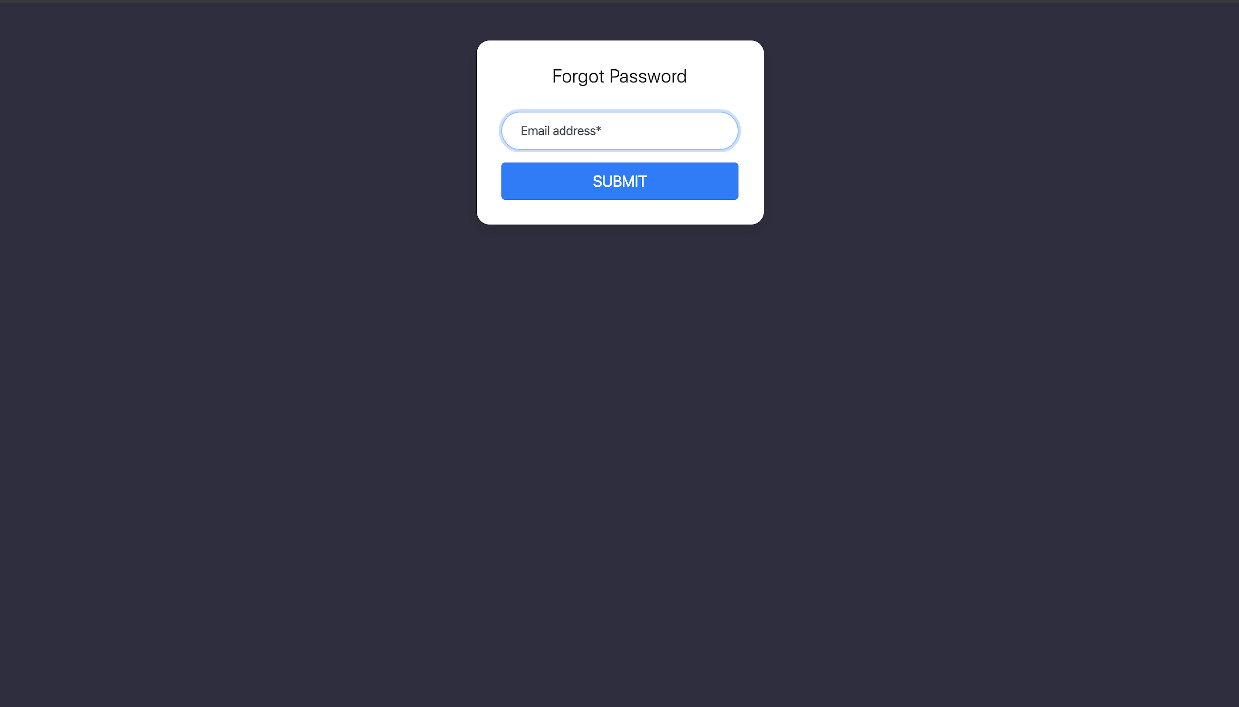
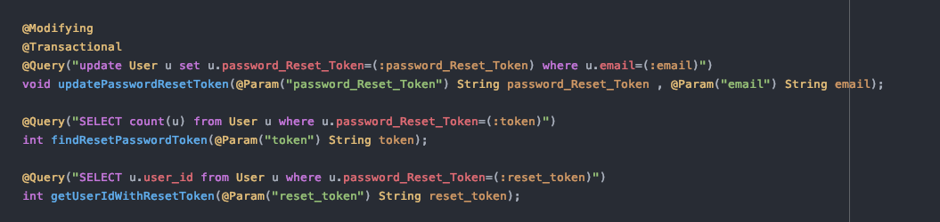
Database Updates Query
User can reset the password from the ‘Sign-in’ View by selecting ‘Forget Password’ button at the bottom which leads the User to the ‘Forget Password’ View.
Here the Application requires the user to enter the email-id where the new reset password link will be sent.
Once the User submit the new password the database resets the password in the database.

Slide 22
Thank You

